Slide 1
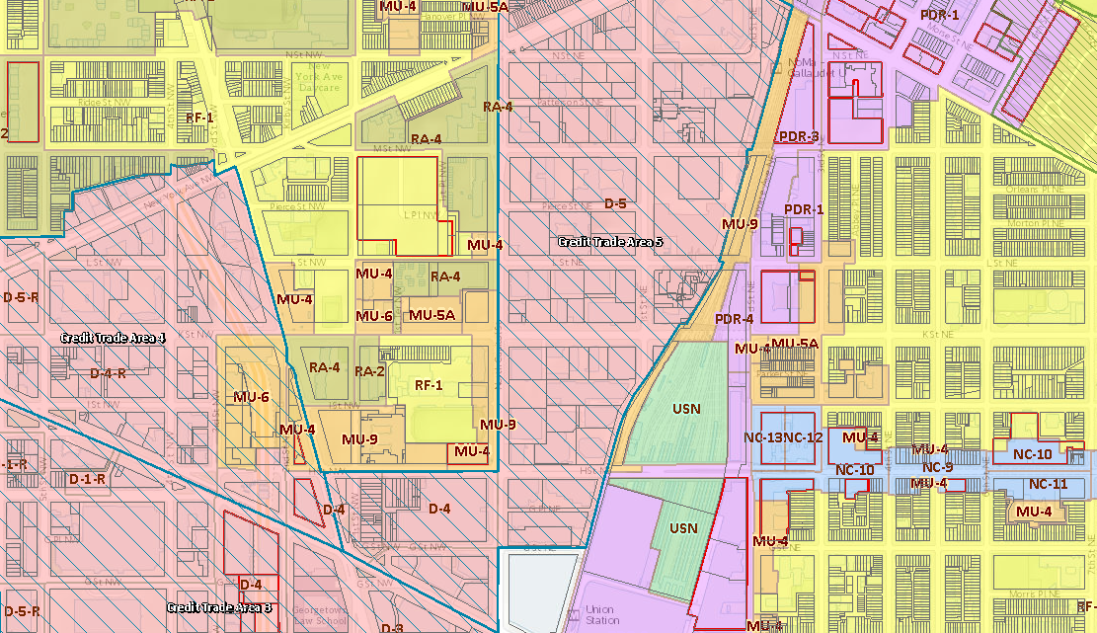
ADVANCED ZONING for ANCs
Training Series by the D.C. Office of Zoning
April 2021

Slide 2
ADVANCED ZONING
Reviewing Applications
Drafting ANC Reports
Weighing in at Setdown (ZC)
Identifying Issues & Concerns
Proposing Conditions
Filing a Petition to the ZC
Filing an Appeal to the BZA
Filing Motions
Responding to Modifications and Time Extensions
Updates for 2021
IZIS & Zoning Map Demo

Slide 3
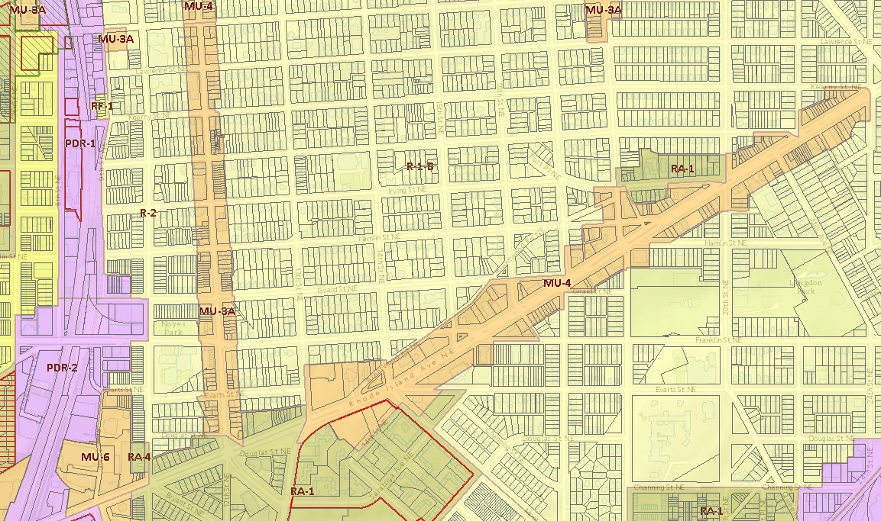
Reviewing Applications

Slide 4
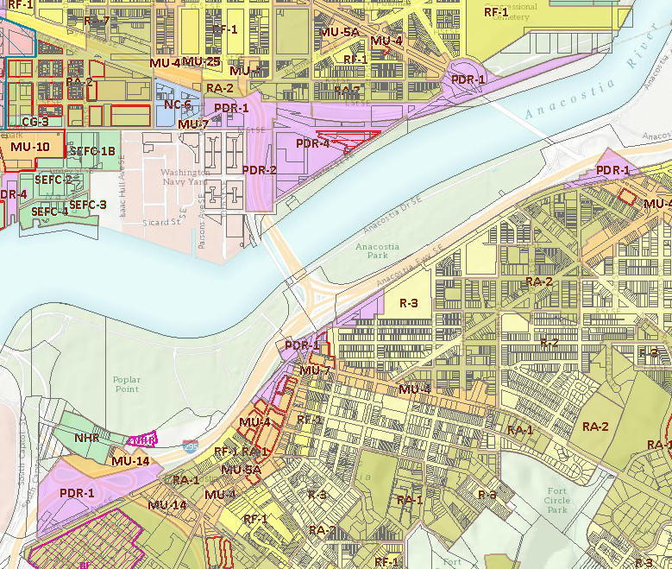
GENERAL CASE TYPES
The BZA and ZC consider two general case types:
Rulemaking:
Includes amendments to the Zoning Regulations and some amendments to the Zoning Map
Deals with matters of policy – “Petitions”
Contested Case:
Includes requests for zoning relief, planned unit developments, and some amendments to the Zoning Map
Deals with a specific project and parties – “Applications”

Slide 5
GENERAL CASE TYPES
RULEMAKING
ANCs Provide Input
CONTESTED CASE
Affected ANC is Automatic Party

Slide 6
NOTICE OF A CASE
Timing of notice depends on the case type
BZA/ZC must meet the notice requirements of the ANC Act and the Zoning Regulations
Notice sent by DCOZ will come to your ANC email account (general account & SMD)
You may receive several forms of notice at different stages of the application
When a case is postponed, it is typically not re-noticed

Slide 7
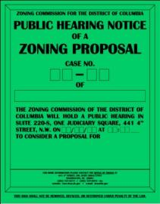
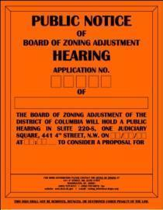
NOTICE OF A CASE
Notice of Intent: In some ZC cases, Applicants mail a notice of intent (NOI) to the affected ANC and to all owners within 200 feet of the property prior to filing
Notice of Filing: Applicants must serve their application on the affected ANC at the time of filing with DCOZ
Notice of Public Hearing: DCOZ provides notice of public hearings on a case to the affected ANC and neighbors within 200 ft. of the property
Notice is also posted on the property before a public hearing

Slide 8
RESEARCHING A CASE
Interactive Zoning Information System (IZIS): https://dcoz.dc.gov/service/interactive-zoning-information-system

Slide 9
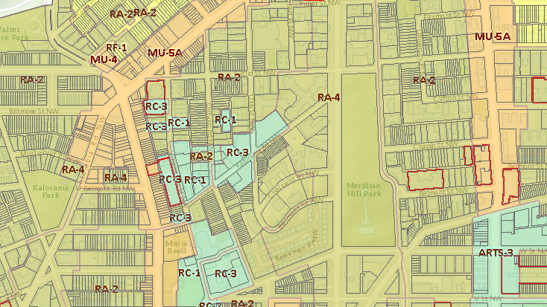
Drafting ANC Reports

Slide 10
DRAFTING AN ANC REPORT
Pursuant to Subtitle Y § 406.2 and Subtitle Z § 406.2, the BZA and ZC shall give “great weight” to the written report of the affected ANC
“Great Weight”
is an acknowledgement of the issues and concerns of the ANC and an explanation of why the ZC or BZA did or did not find the ANC persuasive

Slide 11
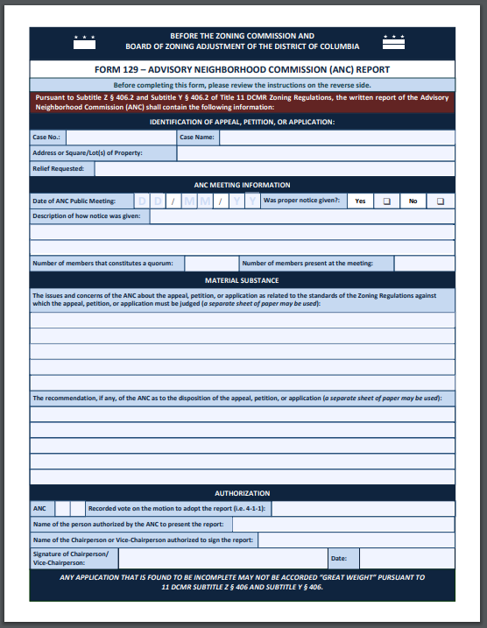
DRAFTING AN ANC REPORT
Requirements for Great Weight (or, see Form 129):
Case name and number;
Date of the public meeting of the ANC
Statement that proper notice of that public meeting was given by the ANC;
Number of members of the ANC that constitute a quorum and number of members present;
The issues and concerns of the ANC about the application, as related to the standards against which the application shall be judged;
Recommendation, if any, of the ANC;
Outcome of the vote on the motion to adopt the report;
Signature of the ANC Chairperson or Vice-Chairperson

Slide 12
DRAFTING AN ANC REPORT
From DC Court of Appeals decision in Metropole Condominium Ass'n v. District of Columbia Bd. of Zoning Adjustment, 141 A.3d 1079 (2016):
As for the recommendation of the ANC supporting the application, we note that the statute does not require the BZA to give “great weight” to the ANC's recommendation but requires the BZA to give great weight to any raised by the ANC in reaching its decision.
issues and concerns

Slide 13
DRAFTING AN ANC REPORT
The great weight requirement extends only to issues and concerns that are
“legally relevant”
What is the issue or concern?
Is it within the BZA/ZC’s jurisdiction?
Is it related to the zoning relief requested?

Slide 14
WEIGHING IN AT SETDOWN
Setdown is the process by which the ZC determines whether a case is ready for public hearing
Prior to ZR16, only Office of Planning could weigh in on this determination
Under ZR16, ANCs may submit a Setdown Form (Form 130) to provide their input on this decision
If the ANC decides to weigh in, the ANC Setdown Form must be filed to the record no later than 30 days after the date the application/petition is referred

Slide 15
WEIGHING IN AT SETDOWN
At this stage, the ANC should not discuss the merits of the case
The ZC determination is only whether the case is generally ready for a public hearing to be scheduled
In the case of a map amendment, the ANC could also weigh in on whether it should be a rulemaking or a contested case

Slide 16
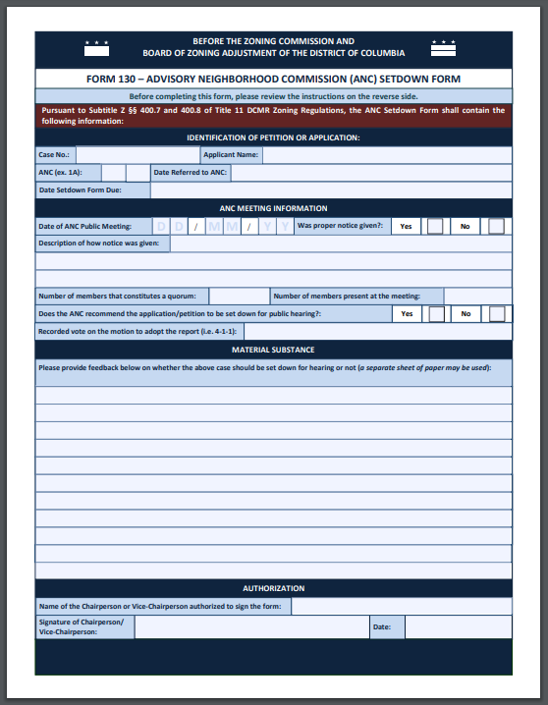
WEIGHING IN AT SETDOWN
Appropriate Issue for Setdown?
The Petition is ready for hearing but should be set down as a contested case because…
The benefits and amenities proposed by the Applicant in this PUD are insufficient for the following reasons…
The plans included in the Application are unclear and additional information is needed…

Slide 17
PROPOSING CONDITIONS
BZA APPLICATIONS
The ANC may propose conditions for the Board to adopt as part of its Order
NOTE: If the ANC makes clear that its support is contingent upon the adoption of certain conditions and the Board does not adopt those conditions, the ANC will be considered opposed to the application
Any conditions should be:
Related to zoning issues (within the BZA’s jurisdiction)
Related to the zoning relief requested (intended to mitigate a potential adverse impact)
Clear and specific enough to be enforceable by the Zoning Administrator

Slide 18
PROPOSING CONDITIONS
BZA APPLICATIONS
Application: Special exception relief from the parking and loading requirements to construct a new 8-unit apartment building in the RA-2 Zone.
Which conditions are most likely to be adopted?
The Applicant shall not apply for an after-hours construction permit.
The Applicant shall provide an annual ZipCar or Capital Bikeshare membership to each new tenant for a period of five (5) years.
The Applicant shall work with the ANC to resolve any issues with on-street truck parking.
The Applicant shall designate a Loading Coordinator for the building, who shall be responsible for scheduling all resident move-ins and move-outs.

Slide 19
PROPOSING CONDITIONS
ZC Planned Unit Developments – Benefits & Amenities
Conditions in a PUD Order are not limited to mitigation PUDs include conditions that finalize the negotiations between the Applicant and the ANC as to the public benefits and amenities proffered
Public Benefit Categories can be found in Subtitle X § 305 and include categories like:
Affordable housing
Employment and training opportunities
Mass transit improvements
Superior urban design and architecture
Environmental and sustainable benefits

Slide 20
PROPOSING CONDITIONS
ZC Planned Unit Developments – Benefits & Amenities
Subtitle X § 305.3: All public benefits shall meet the following criteria:
Tangible and quantifiable items;
Able to be completed or arranged prior to issuance of a certificate of occupancy;
May primarily benefit a particular neighborhood or area of the city
Monetary contributions only permitted if:
Made to a District of Columbia government program OR
No certificate of occupancy may be issued unless the applicant provides proof to the Zoning Administrator that the items or services funded have been or are being provided.
Subtitle X § 305.4: A majority of public benefits of the proposed PUD should relate to the geographic area of the Advisory Neighborhood Commission in which the application is proposed.

Slide 21
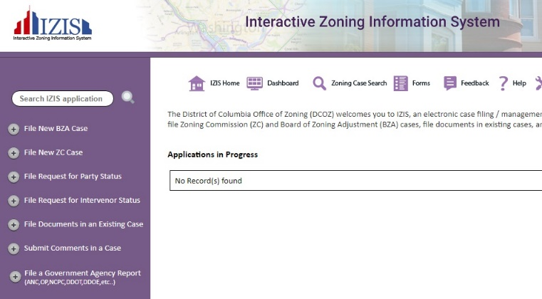
FILING AN ANC REPORT
Create an account in IZIS to upload pdfs instantly
to the case record
Backup submission email accounts:
BZAsubmissions@dc.gov – for BZA cases only!
ZCsubmissions@dc.gov – for ZC cases only!
NOTE: Electronic submissions must be filed via IZIS or via the backup email accounts listed above; sending an email to DCOZ staff is not enough to ensure filing!

Slide 22
FILING AN ANC REPORT
SUBMISSION DEADLINES
ANC Reports must be filed before the case is decided (but ideally as soon as possible)
If the ANC wishes to participate as a party in the hearing, ANC Reports are due at least 7 days before the hearing
NOTE: This is different than the deadline for submissions from the public, which are due at least 24 hours before the start of the hearing session.

Slide 23
Filing Cases
BZA Appeals & ZC Rulemaking Petitions

Slide 24
FILING PETITIONS TO THE ZC
An ANC may file a petition for a text or map amendment to the ZC
Petitions must be filed through IZIS: https://app.dcoz.dc.gov/Login.aspx
Filing Requirements
See Subtitle Z § 304 for map amendments
See Subtitle Z § 305 for text amendments
Process
Once submitted and accepted as complete, the ZC will consider the petition when OP files a setdown report
If set down, the ZC can hold a public hearing, then publish a Notice of Proposed Rulemaking
After reviewing any comments received, ZC can take final action

Slide 25
FILING APPEALS TO THE BZA
An ANC can challenge a decision made by an administrative officer or body in the administration or enforcement of the Zoning Regulations
Did the Zoning Administrator (or other zoning official)
err in interpreting or applying the Zoning Regulations?
Filing Requirements
See Subtitle Y § 302.12 for the required information
What decision is being appealed?
Is the appeal timely? (60-day deadline)
What are the zoning issues on appeal?
Must be filed through IZIS: https://app.dcoz.dc.gov/Login.aspx
Can contact BZA staff and send to bzasubmissions@dc.gov if there are issues

Slide 26
FILING APPEALS TO THE BZA
Timeliness: The appeal must be filed within 60 days from the date the person filing the appeal:
Had notice or knowledge of the decision complained of, OR
Reasonably should have had notice or knowledge of the decision complained of
Whichever is earlier (Subtitle Y § 302.2)
The 60-day deadline can be waived by the Board if:
Exceptional circumstances outside of the Appellant’s control impaired the ability to file the appeal
Waiver will not prejudice the parties to the appeal

Slide 27
FILING APPEALS TO THE BZA
First Writing Rule: The determination being appealed must be the first writing where the issue is decided (Subtitle Y § 302.5)
January 2020
Permit No. 1 is issued
The permit contains an error in FAR calculation
January 2021
Permit No. 2 is issued
Permit No. 2 revises certain aspects of Permit No. 1
The FAR calculation remains the same
If the issue being appealed is the FAR calculation, then:
Permit No. 1 is the first writing, and Permit No. 2 does not re-start the clock for an appeal
NOTE: The timeliness of an appeal and what constitutes the first writing are ultimately decided by the Board

Slide 28
Filing Motions
Requesting Postponement, Reconsideration, or Rehearing

Slide 29
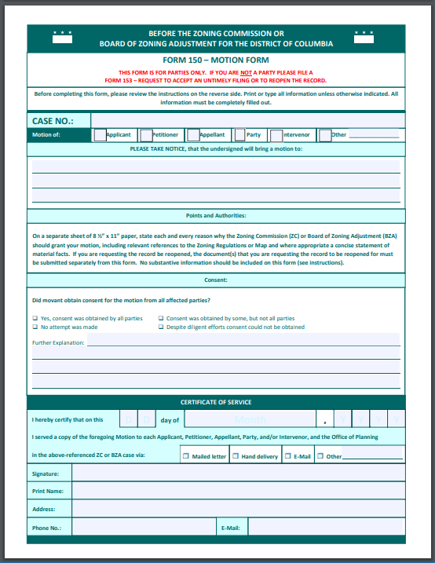
FILING MOTIONS
In ZR16, rules for motions in contested cases were adopted in the BZA/ZC procedural regulations
(Subtitle Y § 407 and Subtitle Z § 407)
A motion is a request by a party for the BZA/ZC to take an action.
Unless made during a hearing, all motions shall be in writing.
At the time of filing any motion, a party must serve all other parties.
Unless otherwise ordered by the presiding officer, all parties opposing a motion shall have 7 days to file and serve a response.
The presiding officer may decide any procedural motion including motions to continue without holding a hearing.

Slide 30
FILING MOTIONS
Request to Postpone a Public Hearing
Make the motion in writing – include request and reasons
Submit the motion to the case record
Upload through IZIS; or
Email to bzasubmissions@dc.gov or zcsubmissions@dc.gov
Send the motion to all other parties
Parties are allowed 7 days to respond, unless the Chair decides otherwise
The Chair may decide the motion or defer to the full Board or Commission

Slide 31
FILING MOTIONS
Request for Reconsideration and/or Rehearing
(Subtitle Y § 700 and Subtitle Z § 700)
A Motion for Reconsideration/Rehearing of a final order in a contested case may be filed by a party within 10 days of the order’s issuance
The motion must be served on all other parties.
Motion for Reconsideration
How is the final order erroneous? What are the errors in fact or law?
Motion for Rehearing
How is the final order erroneous? What is the newly discovered evidence?
No request for rehearing shall be considered unless new evidence is submitted that could not reasonably have been presented at the original hearing

Slide 32
Responding to Modifications & Time Extensions

Slide 33
MODIFICATIONS
After a final order is issued, an Applicant may request:
Minor Modification (without Hearing)
Modification of Consequence (without Hearing)
Modification of Significance (with Hearing)
Subtitle Y § 703-704 and Subtitle Z § 703-704
do not allow the BZA/ZC to revisit the entire case, only to consider what is being added or modified.
Modifications

Slide 34
TIME EXTENSIONS
After a final order is issued, an Applicant may request:
An extension of the order’s validity
Subtitle Y § 705 and Subtitle Z § 705
Time Extensions
do not allow the BZA/ZC to revisit the decision in a case, only to decide whether there is good cause to extend the validity of the order.

Slide 35
ANC RESPONSES
Affected ANCs will be served with any request for modification or time extension.
The ANC can provide input on the request in the form of an ANC Report filed to the record
Make sure the issues & concerns are relevant to the request
For modifications that require a public hearing, the affected ANC may participate as a party, as with any contested case

Slide 36
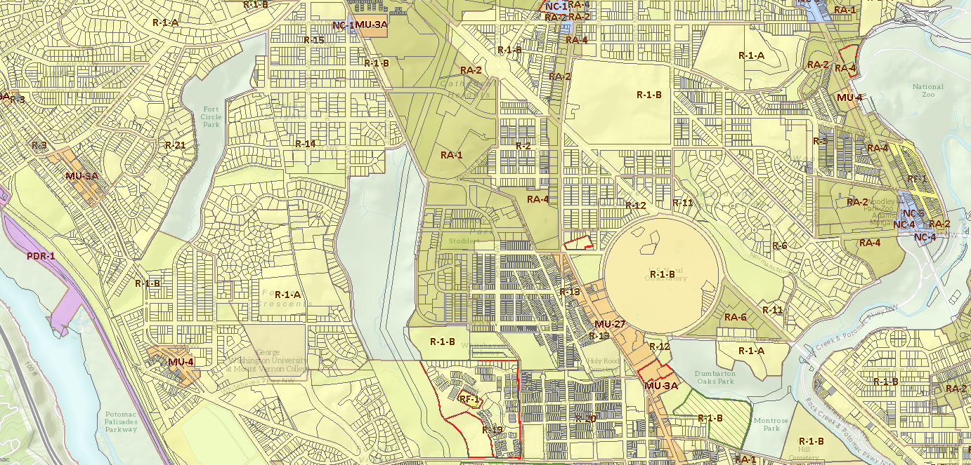
Updates for 2021
Regulatory Changes and Virtual Hearing Procedures

Slide 37
UPDATES IN 2020-2021
INCLUSIONARY ZONING
The Zoning Commission is considering text amendments to expand the existing IZ program.
NOTICE
Per DC Council Action, there is an extended notice period required (51 business days before hearing date) for ANCs while public health emergency is declared.
SUBMISSIONS
Submissions are now due to the record at least 24 hours before hearing session starts, unless the filing is an ANC report.
VIRTUAL HEARINGS
The BZA and ZC are holding all public hearings and meetings virtually via Webex.
Regulatory Changes and Virtual Hearing Procedures

Slide 38
VIRTUAL HEARINGS
HOW TO WATCH OR LISTEN
Watch live via Webex, YouTube; listen via phone
Available next day on DCOZ Website and on YouTube
HOW TO SIGN UP TO PARTICIPATE
Fill out form on DCOZ website
https://dcoz.dc.gov/service/sign-testify
Sign up with DCOZ staff
ZC: 202-727-0340
BZA: 202-727-5471

Slide 39
VIRTUAL HEARINGS
New Virtual Hearing Procedures
Subtitle Y § 103.13 and Subtitle Z § 103.13
Mostly follows existing hearing procedures, but with extra safeguards
Must sign up in advance to testify
No “live video” during testimony
Request to reopen record if technical difficulties

Slide 40
Using the Zoning Map & Interactive Zoning Information System (IZIS)

Slide 41
Interactive Zoning Information System (IZIS)
Searching Case Records: https://app.dcoz.dc.gov/CaseReport/CaseSearch.aspx
Filing a Case / Uploading Documents:
https://app.dcoz.dc.gov/Login.aspx

Slide 42
Official Zoning Map
https://maps.dcoz.dc.gov/zr16

Slide 43
QUESTIONS?
Please feel free to contact us:
Allison Myers, General Counsel
allison.myers@dc.gov / 202-727-2806
Sharon Schellin, Secretary to the Zoning Commission
sharon.schellin@dc.gov / 202-727-0340
Clifford Moy, Secretary to the Board of Zoning Adjustment
clifford.moy@dc.gov / 202-727-0348

